Slide 1
OWASP 2017 A9-Using Components with Known Vulnerabilities
Déaglán Connolly Bree - 15511107
Anushkha Vadhera- 15204395
Brian McDermott - 15730891
Notes:
Hey, so we are group 3, myself deaglan, anushkha, and brian and today we’re going to be talking about the use of components with known vulnerabilities in software.

Slide 2
Agenda
Introduction
How this vulnerability occurs
Case Studies
Method of exploitation
Demo
Mitigation
Notes:
We have this plan of action, then we’ll discuss how and why this vulnerability occurs. We have a couple of case studies we’ll talk you through, then we’ll have a demo - there is a challenge for this in webgoat but it doesn’t work unfortunately so we recorded a wee demo, and then finally we’ll discuss possible mitigations and conclude

Slide 3
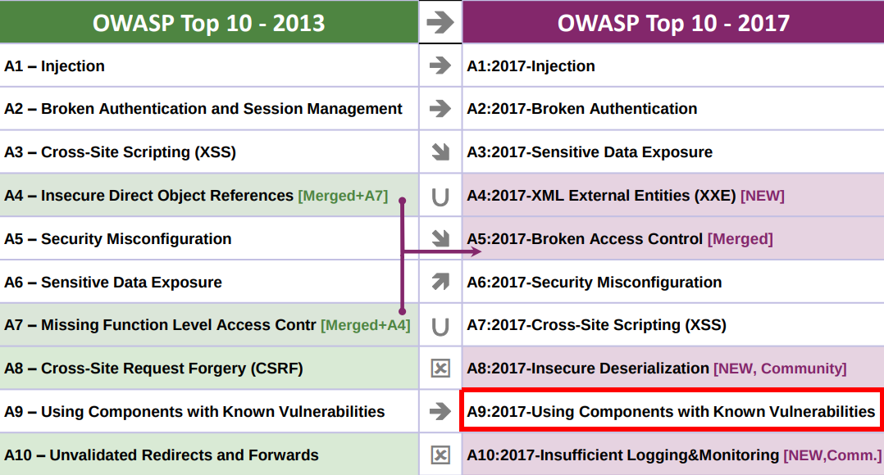

Introduction
Remains 9th on the OWASP Top - 10 2017
Very common, but hard to find
Code dependencies are the Devil
Code dependencies are necessary
Find a balance, and develop appropriately
Notes:
The use of components with known vulnerabilities stayed at number 9 on the owasp top 10, it is seen in a lot of code, and its occurance will probably only increase with the growth of use of frameworks and libraries and the huge growth of internet of things. While it’s very common, it can be difficult to find, detailed reasons for which we’ll discuss a little later on, but the main point to remember is that code dependencies are the Devil - but at the same time are necessary - I’m sure we’ve all developed software at this point that uses some external library, there’s no point in reinventing the wheel, but I’ve never looked through that code to make sure it’s secure, nor have I searched vulnerability databases to find them. To be fair, for our assignments nobody really cares, but in industry, the development process should be more stringent to try to avoid exploits.

Slide 4
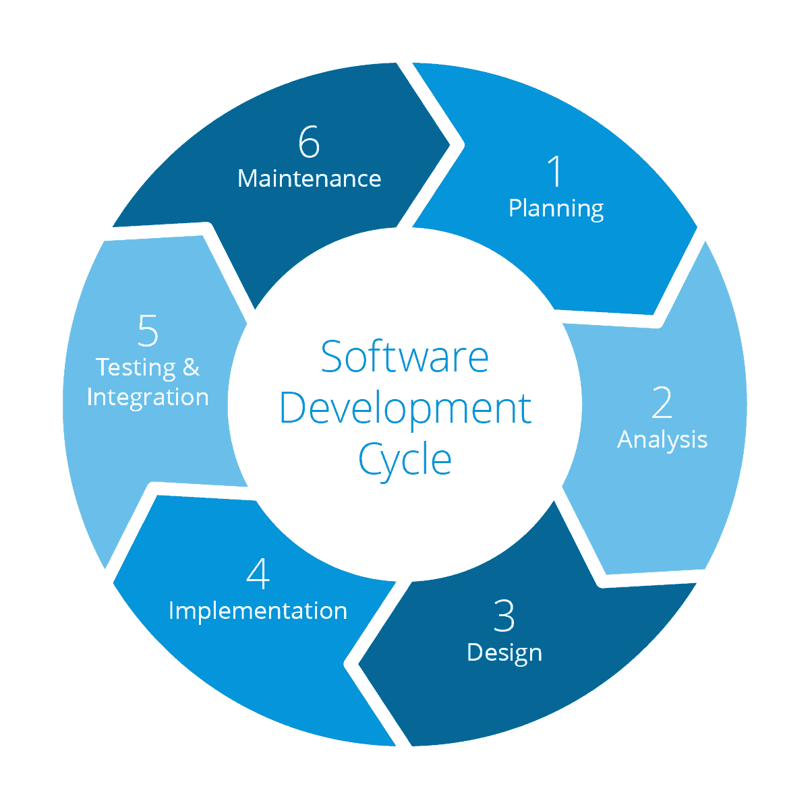
How does this vulnerability occur?
Implementation & Maintenance
Introduction of dependencies
OS, web server, DBMS, APIs, runtime environments, libraries
Software configurations (OWASP A6)
Long term maintenance and updating
Notes:
So how does a vulnerability like this occur - as we develop code, we’ll often develop on frameworks, or use external libraries or software components to get us to production code faster, and on top of all of this, we have to consider the operating system the software runs on, the server back end, the DBMSs, the APIs and runtime envrionments - there’s a lot of code being run that you or I will never read, we just trust it works. On top of that, for any components we use you have to make sure they’re all configured correctly, running into another member of the OWASP top 10, and lastly, code often isn’t maintained as it should be

Slide 5
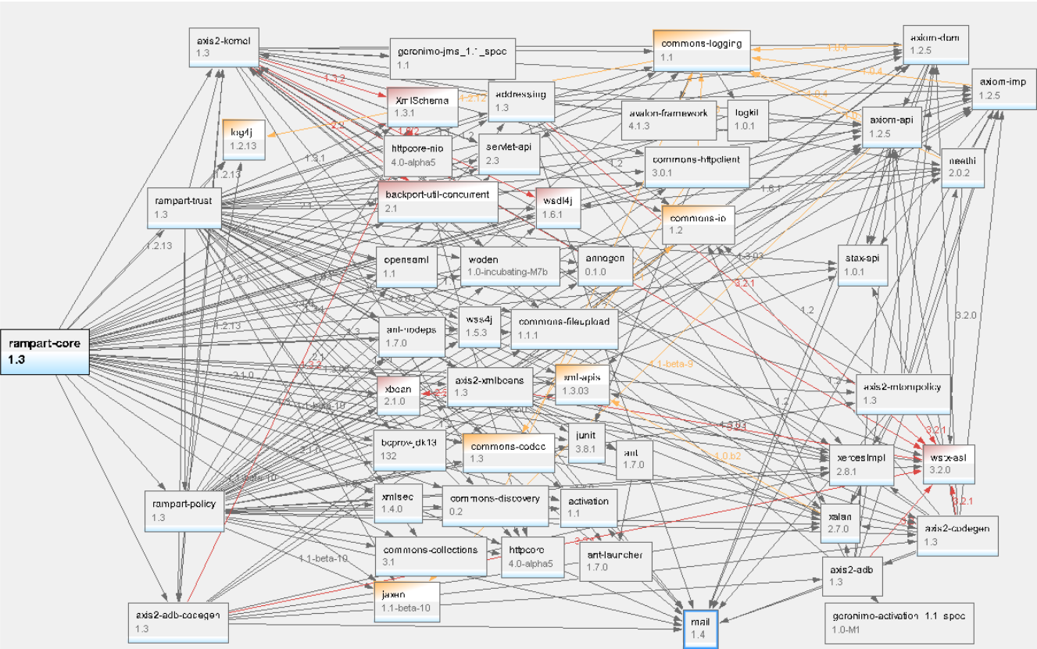
Open Source Dependencies
91% of software projects contain indirect open source dependencies
Code authenticity
Dependency versions
Lack security patches, often opt to patch in next major update
Pre-existing vulnerabilities
Notes:
An enormous amount of code runs on open source software, some studies show 91% have an open source dependency, this creates more problems. You have to try to make sure the component you’re using is authentic, that it hasn’t been maliciously edited. When we introduce them to the project we also have to consider the various versions that exist, and any vulnerabilities that might already exist and be well known. The last thing about open source software is that in some cases, they lack security patches, instead opting to patch problems in the next update

Slide 6

Case Study - Equifax (September 2017)
Scored as critical (CVSS 10)
Root cause of the breach was an Apache Struts vulnerability - CVE-2017-5638*.
Apache Struts was available for developers to update any vulnerable version they might have, since March 7, 2017.
Widespread risk -> According to a Security Statistics report, about 65% of the fortune 100 companies use Apache struts
*In Apache Struts 2 2.3.x before 2.3.32 and 2.5.x before 2.5.10.1 has incorrect exception handling and error-message generation during file-upload attempts, which allows remote attackers to execute arbitrary commands via a crafted Content-Type, Content-Disposition, or Content-Length HTTP header, as exploited in the wild in March 2017 with a Content-Type header containing a #cmd= string.
Notes:
Equifax is one of the major credit score companies, which had a serious data breach in september 2017. It was of high criticality as the vulnerability can be easily exploited by the attackers. Equifax were using Apache Struts framework for developing Java EE web application, which had some known vulnerabilities - …. .An update for the vulnerable versions was accessible to all developers but due to mere negligence, equifax did not update their software versions. The attackers took advantage of this vulnerability to gain critical consumer information of the consumers - social security numbers, drivers license, among the few. About 143 million U.S. consumers were effected by this data breech

Slide 7

Case Study - Mossack Fonseca (Panamanian Law Firm)
11.5 million files documents of the firms most sensitive clients - Like Putin’s inner circle, Prime minister of Iceland
Customers access to data via a web portal running a vulnerable version of Drupal (Content management Framework)
Website runs on WordPress
Version of Revolution Slider which was vulnerable to attack
It was able to grant a remote attacker a shell on the web server.
Revolution Slider (also known as Slider Revolution) version 3.0.95 or older is vulnerable to unauthenticated remote file upload. It has an action called `upload_plugin` which can be called by an unauthenticated user, allowing anyone to upload a zip file containing PHP source code to a temp directory within the revslider plugin.
Notes:
Mossack Fonseca a Panamanian Law firm experienced a huge data breach, where in documents of some of the most sensitive clients like Putin’s inner social circle and prime minister of Iceland to name a few was leaked. It exposed many big companies for evasion of tax. Basically, MF web portal and the email was hosted on the same server and used username and password to grant access to the customers.

Slide 8
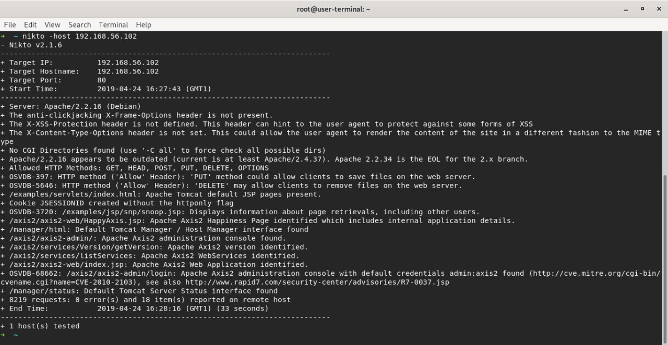
Attacker finds the version of some component the application is using
Attacker searches for vulnerabilities with that component
Attacker finds an exploitable vulnerability
Attacker causes chaos, steals data, makes money, gains street cred
Attacker uses the exploit to damage/access/crash the application
Notes:
From an attackers perspective, they find some software, like a website, and they figure out what piece of software it’s running on. We used a tool here called nikto which you can just throw a url into, and not only will it show you the software that’s running on the server, but it’ll even present vulnerabilities that exist. With those vulnerabilities an attacker can exploit them to make gain access to data or money etc etc

Slide 9

Demo
Notes:
So, when you use vulnerable components, either because you haven’t vetted them properly or you go too long without patching your systems, you leave yourself open to exploitation.
Exploits are now well documented and frequently easy to reproduce.
It’s also easier than ever before to discover new vulnerablities. There are all sorts of scanners out there. (Sqlmap, directory spiders, scanners like nikto)

Slide 10
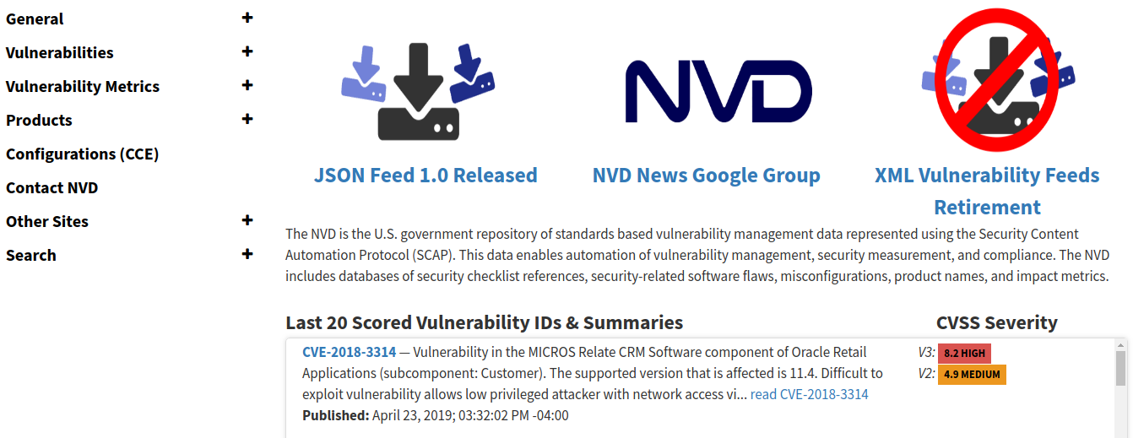
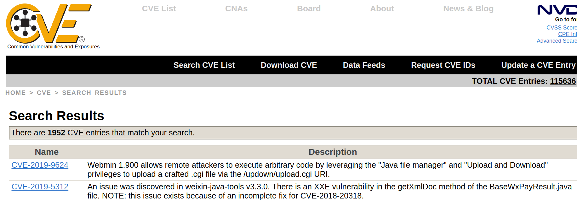
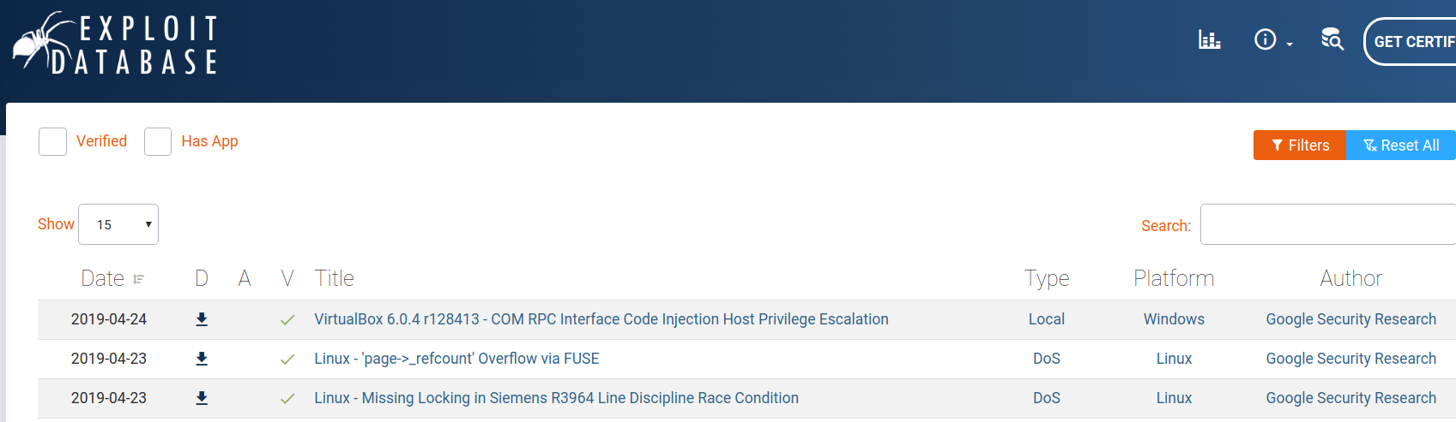
Mitigation
Maintain inventory of all components & their dependencies
OWASP Dependency Check
Monitor vulnerability/exploit databases, project newsletters & mailing lists for used components
National Vulnerability Database, Common Vulnerabilities & Exposures, Exploit Database

Slide 11
Mitigation
Write all the code yourself - Impractical
Establish security policies - best practices for component use
Remove any functionality or dependencies that are not used
Minimise attack vectors
Run security checks - in and out of house
Penetration tests
Notes:
So there are a bunch of ways of avoiding this - the first of course it to write all the code yourself, use no unknown software components, wonderful...but not very practical
Instead industry companies should introduce best practices for component use. Documententing them all, checking which licenses are accepted. They should implement security wrappers, to disable any functionality of the component that they don’t intend to use, and they should of course run security checks, in house, and employ external pentesters to ensure the application is secure
You are fully in charge of the software, but you may be reinventing the wheel. It may be a lot of extra work.

Slide 12

Mitigation
Maintain and update all components (Patch!)
Custom code AND dependencies
Deploy virtual patches as temporary measures
Analyses transactions & intercepts attacks in progress
Join a bug bounty program...
Many more eyes looking out for issues
Worthwhile investment
Notes:
In the short term, virtual patches can be used...these analyse transactions on the website and incept any attackers...stopping any exploitation of vulnerabilities...but this isn’t really the best method. The program should be maintained and updated, both the code itself, and the components being used should be updated appropriately

Slide 13
Conclusion
Modern programs make use of many pre-existing components
The components being used (and their versions) is hard to keep track of
New exploits are constantly being found
Developers need to stay on top of:
Vulnerabilities of their own software
Vulnerabilities in all of the components used
Notes:
To conclude, a brief overview...as we all know any modern piece of software runs with a bunch of external components. Keeping track of which components are being used is hard with so many of them, and in many cases, components depend on other components. With new vulnearbilities constantly being found - the developers need to stay on top of updating the software, as well as following good practise such as setting configurations properly and disabling any functionality they don’t intend to use.

Slide 14

Resources:
https://www.owasp.org/images/7/72/OWASP_Top_10-2017_%28en%29.pdf.pdf
https://www.owasp.org/index.php/Top_10-2017_A9-Using_Components_with_Known_Vulnerabilities
https://www.owasp.org/index.php/OWASP_Dependency_Check
https://nvd.nist.gov/
https://cve.mitre.org/
https://www.exploit-db.com/
https://www.cirt.net/Nikto2
https://www.whitesourcesoftware.com/news/companies-miss-complying-open-source-licenses-due-indirect-dependencies/
https://snyk.io/blog/78-of-vulnerabilities-are-found-in-indirect-dependencies-making-remediation-complex/

